Slide 1
Notes:
Please view as a slideshow.

Slide 2
AMAAN’S FAVORITE FILMS OF ALL TIME

Slide 3




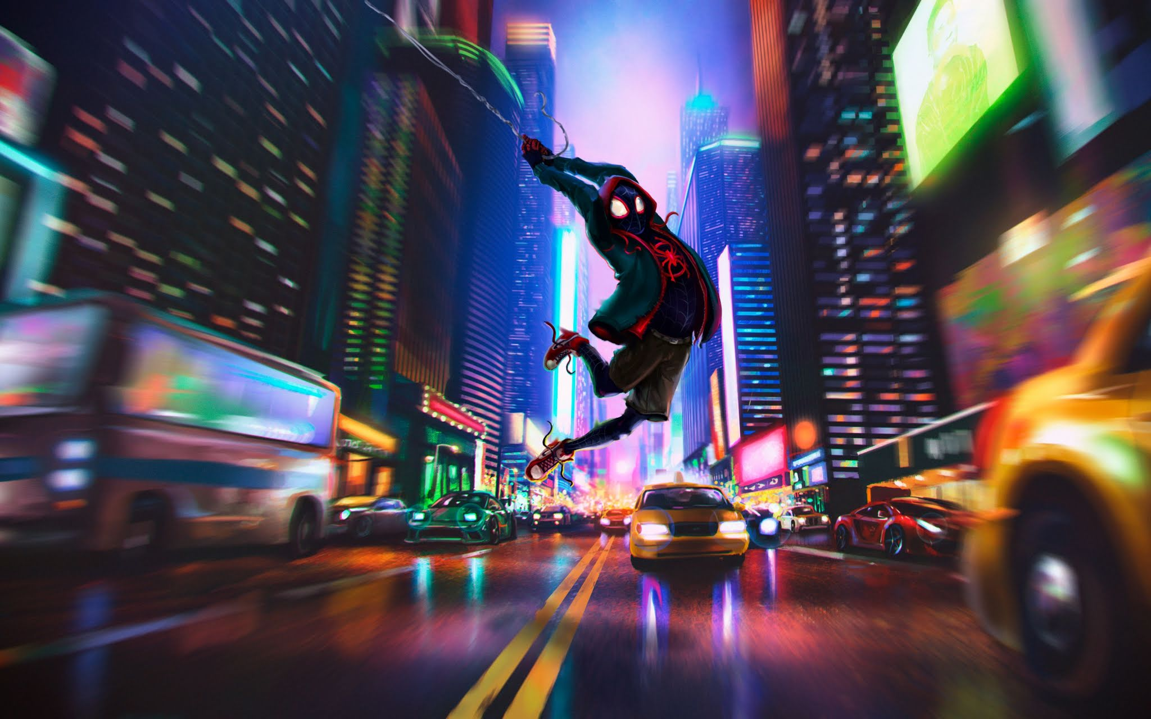


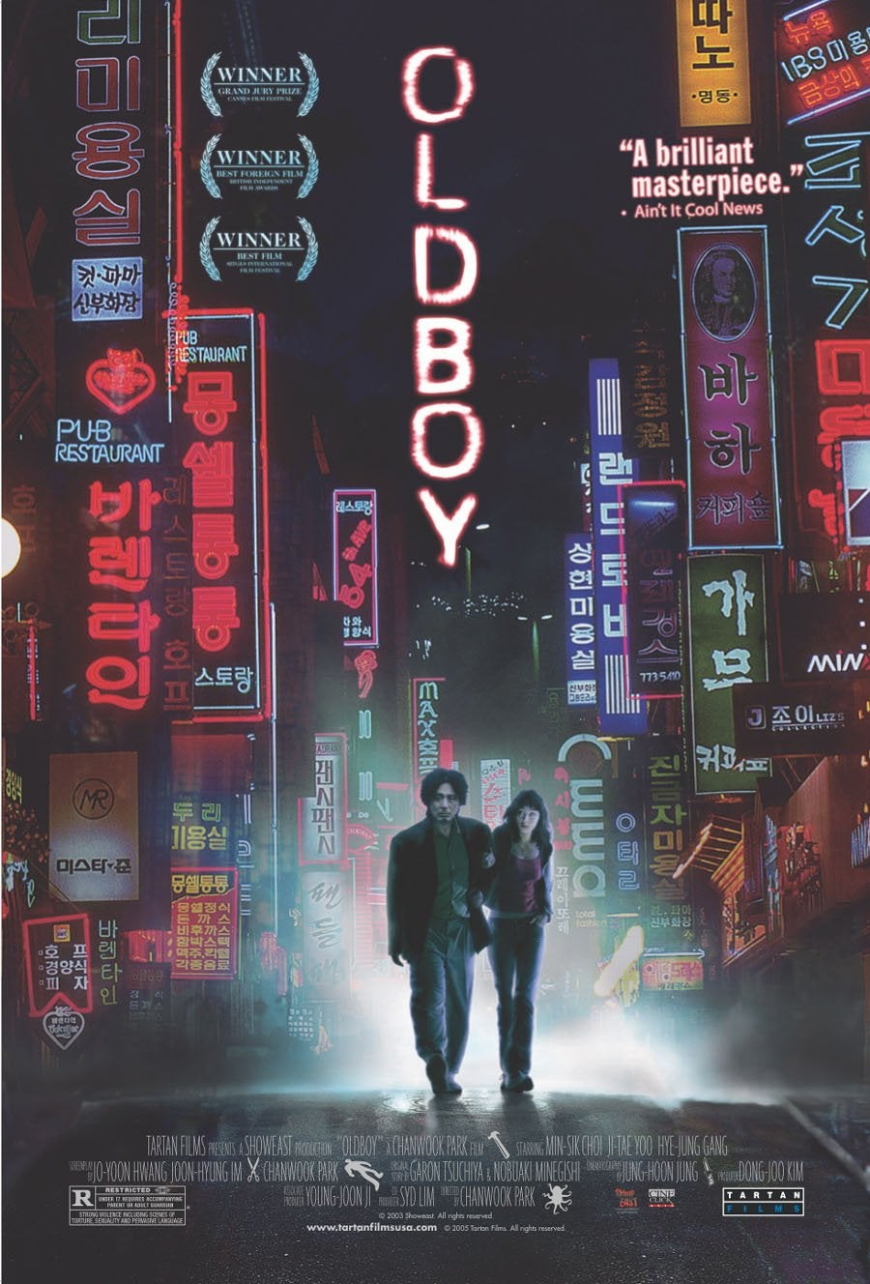
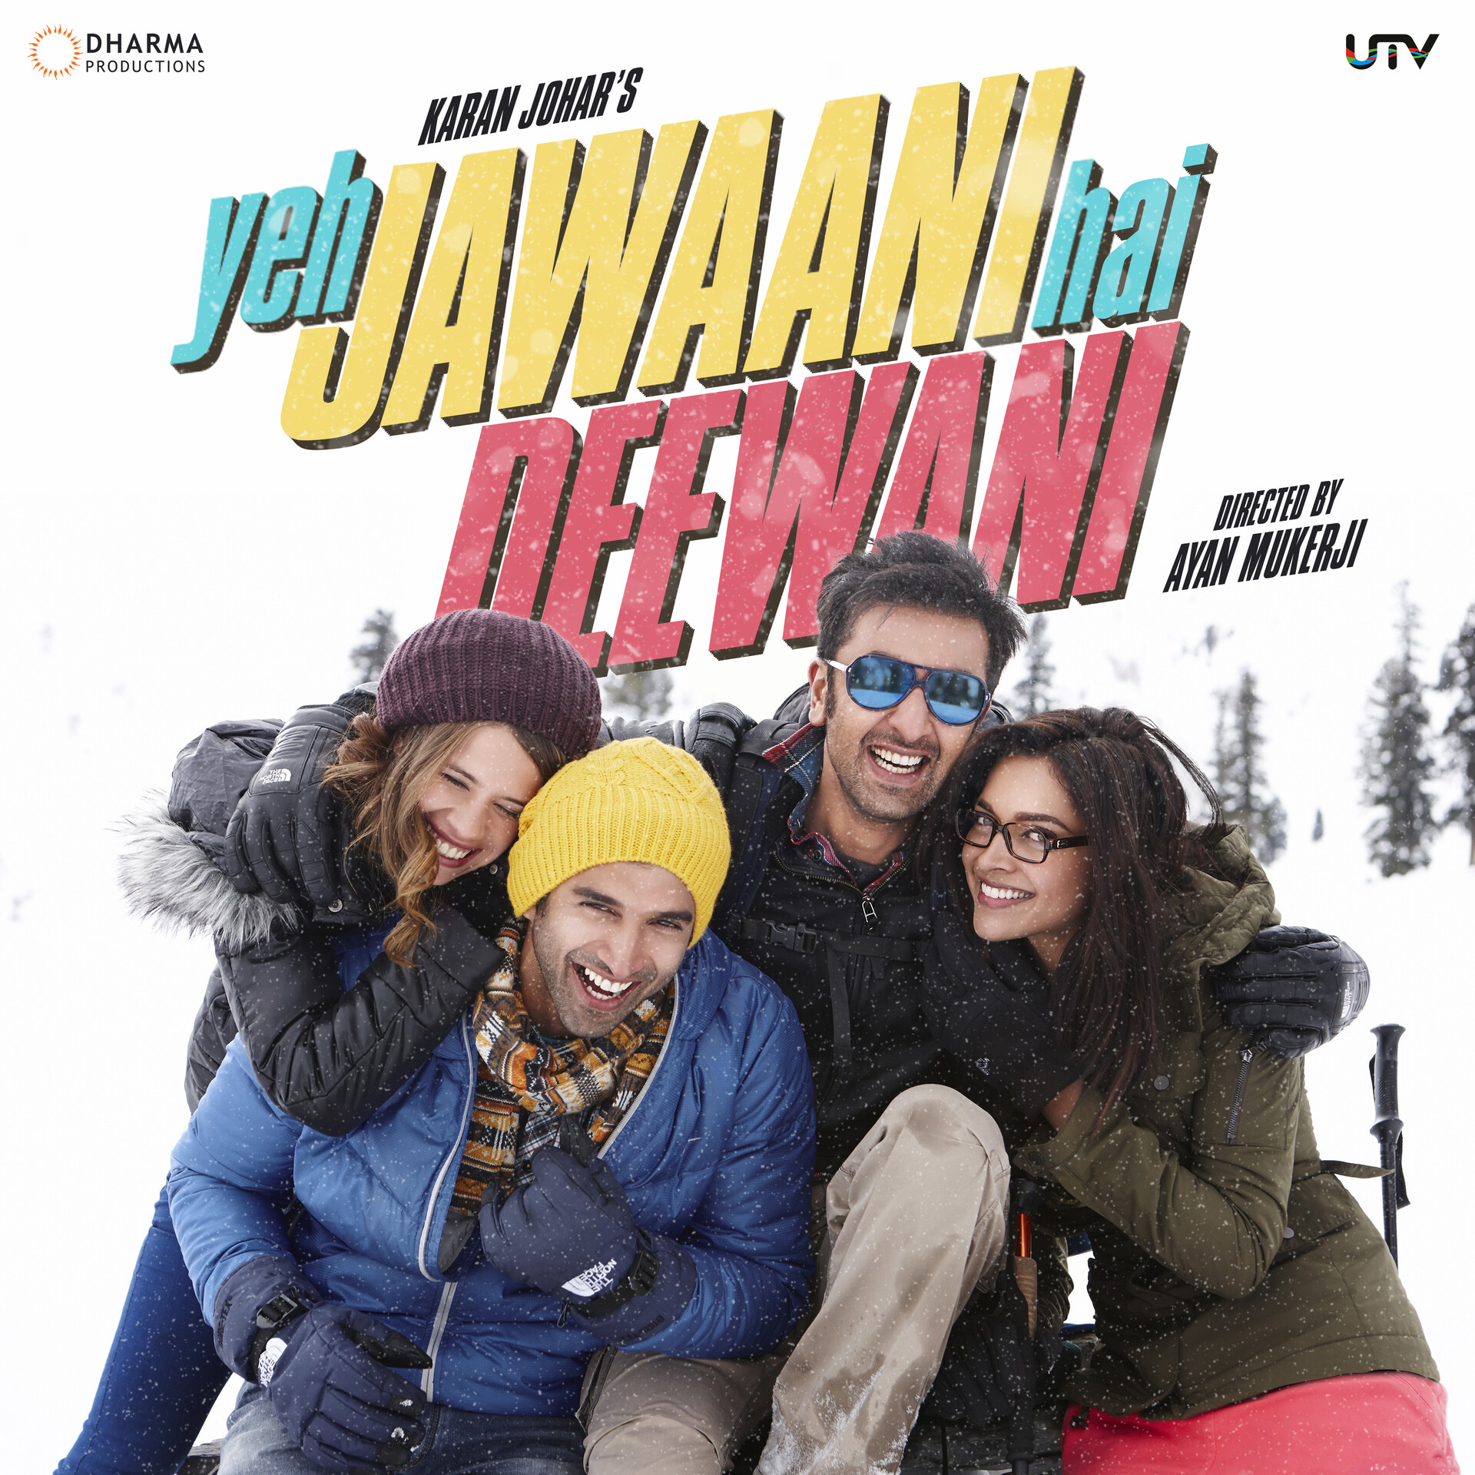
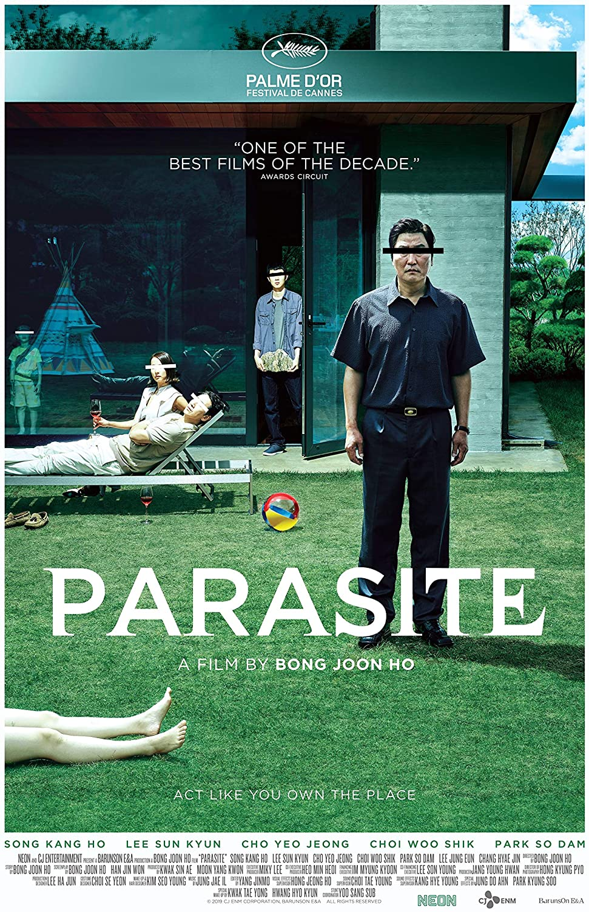
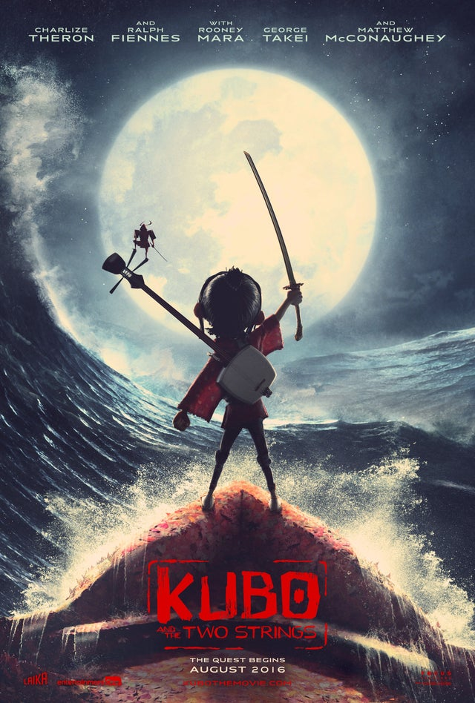
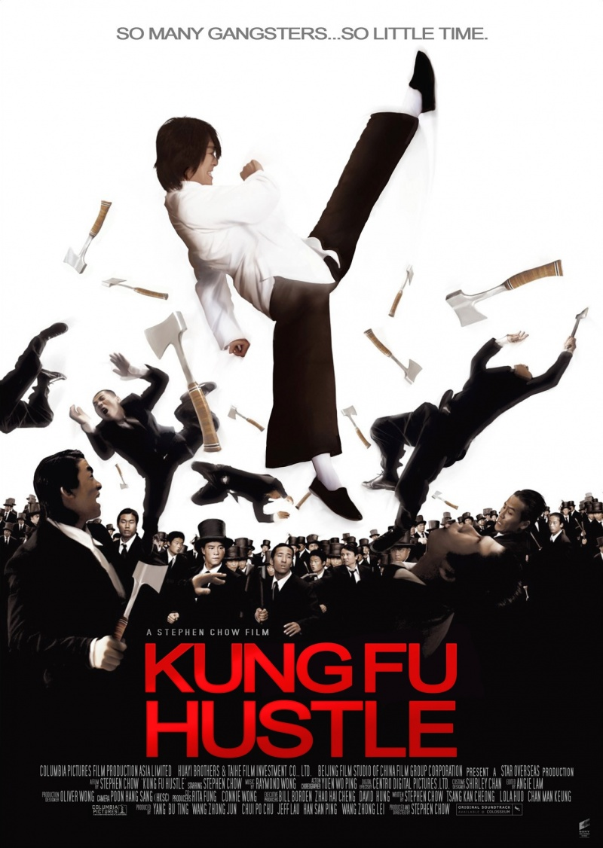
Favorite Movies
1 2 3 4 5

Slide 4

1
OLDBOY
A film that for many has acted as a gateway to South Korean cinema, Oldboy, the second part of Park Chan-wook’s ‘Vengeance Trilogy’ is also his most infamous. Still revered today across all kinds of screen arts, its most famous sequence, a virtuoso single-take hallway fight, has inspired various imitators for well over a decade. But what makes Oldboy special is its consideration of the violence that it portrays – with each blow of the hammer, the film responds: “even though I am no better than a beast, don’t I have the right to live?”
Based on a manga of the same name, Oldboy is the story of Oh Dae-su (Choi Min-sik), the film’s protagonist and victim. He’s introduced as an ordinary white-collar businessman, missing his daughter’s birthday after a night of drinking lands him at the police station. Shortly after being bailed out, he disappears without a trace, imprisoned for 15 years and then suddenly released with no explanation as to why, left with five days to find the answer.
OLDBOY (2003)

Slide 5
2
Yeh Jawaani Hai Deewani
YJHD is not a movie, it's an emotion. All of us had one character which we could all relate to. We might be a Kabir trapped inside a Naina or an Aditi who can't express love to her best friend.
The chemistry between the two main characters, Bunny and Naina is the core of this movie. In the first half, when the both of them go out on a trek, it's Bunny who is playing the protagonist and teaching Naina how to live life and to make the most out of it. Whereas, in the second half, when they re-unite, it's Naina who plays the protagonist teaching Bunny how life is actually lived.
"Kyuki jitna bhi try karo, kuch na kuch toh chutega hi, isliye yahi iss pal ka maza lete hai?“
We run so much in life to achieve each and every thing that we sometimes end up hurrying a lot. In this hurry, we miss our moments and moreover our people. YJHD, not only in terms of your career, but in general makes us realize that's it's not about chasing what you don't have but embracing what you have and the people you are with. Because in the end that's all you will have.
YJHD (2013)

Slide 6
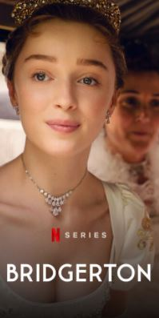
3
PARASITE
As a film about a family imposing on another, and keeping dark secrets hidden beneath the surface, Parasite achieves to tell a multi-layered story in a widely entertaining manner, but without sacrificing the believability of its central narrative. When it comes to crafting weighty social commentaries under the guise of lighter fare, writer-director Bong Joon-ho is in a class of his own. The film follows a lower-class South Korean family as they slowly integrate themselves in the lives of an upper-class family and their lavish household. As their entanglement is spun out of a web of deceit, the lowly family find themselves skating on thin ice when it comes to keeping up appearances. It's a twisty satire on social-economic disparities in South Korean society that swings broadly in tone, and sometimes threatens to tip over the edge, but never feels less than meticulously calculated in its tonal shifts. However, to reveal anything more about the story would be to take away from the overall experience, as each act is marked by a major plot twist or revelation that keeps the film one step ahead of the viewer at all times. Go in blind if you can and expect an unforgettable ride.
PARASITE (2019)

Slide 7
4
Kubo and the Two Strings
The story of Kubo, a boy with supernatural gifts who inadvertently summons vengeful spirits from his past, is set in a feudal Japan infused with enchantment. Kubo supports his ailing mother as a storyteller, his tales illustrated with bewitched origami figures that dance and act out the narratives he accompanies on a three-stringed lute. There is a lyrical quality to the writing, which is a refreshing alternative to the slapdash slang assault of many family films. One day Kubo ignores his mother’s warning and stays out at night, allowing his malevolent aunts to find him. Kabuki-masked, with long, witchy hair and voices loaded with snickering ill will, they look like escapees from any number of J-horror movies. They are just one of the genuinely creepy elements that may prove challenging for younger children. Kubo’s sorceress mother sacrifices herself to save him, sending him on a journey accompanied by a permanently exasperated monkey (voiced to laconic perfection by Charlize Theron) and an amnesiac samurai turned stag beetle.
Kubo’s quest, swept along by Dario Marianelli’s gorgeous, surging score, takes him through lands as exquisitely realised as anything in Zhang Yimou’s sumptuous martial arts fantasy Hero. It sees him do battle with a skeleton monster that is a direct descendant of Ray Harryhausen’s bony warriors from Jason and the Argonauts. And it explores unexpectedly profound ideas of rebirth and destiny rewritten, like origami paper sheets refolded into another form.
KUBO (2016)

Slide 8
5
Kung Fu Hustle
Asian perfection.
Kung Fu Hustle is a black comedy martial arts movie directed and starred by Stephen Chow, so you can expect this to be a riot. Outrageously funny and with warmth on key sequences, Kung Fu Hustle favorably blended martial arts, soothing Asian music, convincing acting and deceptive comedy to draw audiences in. This film more than entertains, it mesmerizes. There were scenes when the screenplay seemed too childish and the plot development was pulled out from nowhere, but as a parody-ish nod to Asian action giants, Kung Fu Hustle favored nostalgia and culture over artistic accuracy. And that made all the difference.
Kung Fu Hustle (2004)

Slide 9


THANK YOU
FOR LISTENING!
Sign In
100% Done
19+
3 Members
Sign Out
Questions? Clarifications FAQ About Us Help Center

